Slide 1



Analyzing Motor Vehicle Collision Types
Data 495 Data Science Capstone
Final Project Presentation
Student Name: Brendan Bloss
Professor: John Cook

Slide 2
Data Analysis Project Description
This dataset gives in depth details on motor vehicle collisions resulting in at least one fatality.
The goal with this project is to find the key variables that have the biggest influence in motor vehicle collisions that result in at least one fatality.
A decision tree model and Naïve Bayes model will be developed to classify each collision into a category (collision type).
In this project, the goal is to classify each collision into a specific collision type (angle, head-on, rear-end, no collision with vehicle in transport…) so the main contributing factors of each collision type are known.

Slide 3
Data Set Description
Contains data collected by the NHTSA on motor vehicle collisions that resulted in at least one death from the year 2022 in the United States.
Includes location data such as latitude/longitude, state, county, and city (if applicable).
Includes time data such as month, day, hour, exact minute, and EMS arrival time.
Variables that describe the actual collision include weather conditions, light conditions, collision type, what the vehicle struck, road function, and intersection type.
The main continuous variables include vehicle total, total number of persons involved, number of pedestrians involved, and total number of fatalities.

Slide 4

Describe the Data
There were roughly 38,700 rows and 70 columns where many of the columns were discrete versions of the categorical variable columns next to it.
There were 9 continuous variables and around 30 unique discrete or continuous variables.
For the collision to be included in the dataset, there must have been at least one death that was a direct result of the collision.
All 50 states including Alaska and Hawaii were included in the dataset. Pedestrians that were struck and killed were also included in the dataset

Slide 5
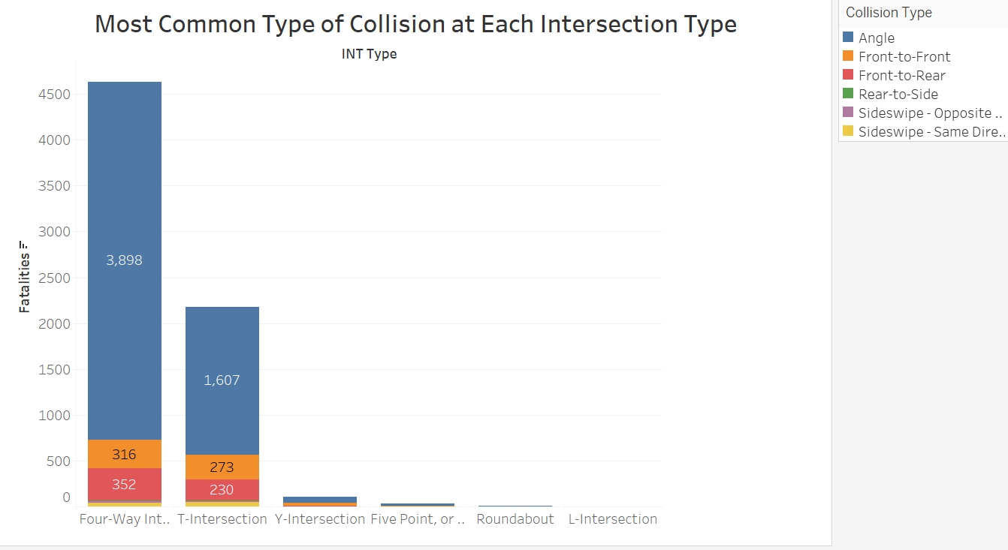
Visualizations
The most common collision type at 4-way intersections and T-intersections were angle collisions.
Roundabouts and L-intersections are the safest intersection type but are far less common than 4-way intersections and T-intersections.
4-way intersections are the most dangerous intersection type because they have a lot of conflict points and a high potential for angle collisions.
Conflict points are where vehicles cross paths, merge, or diverge.

Slide 6
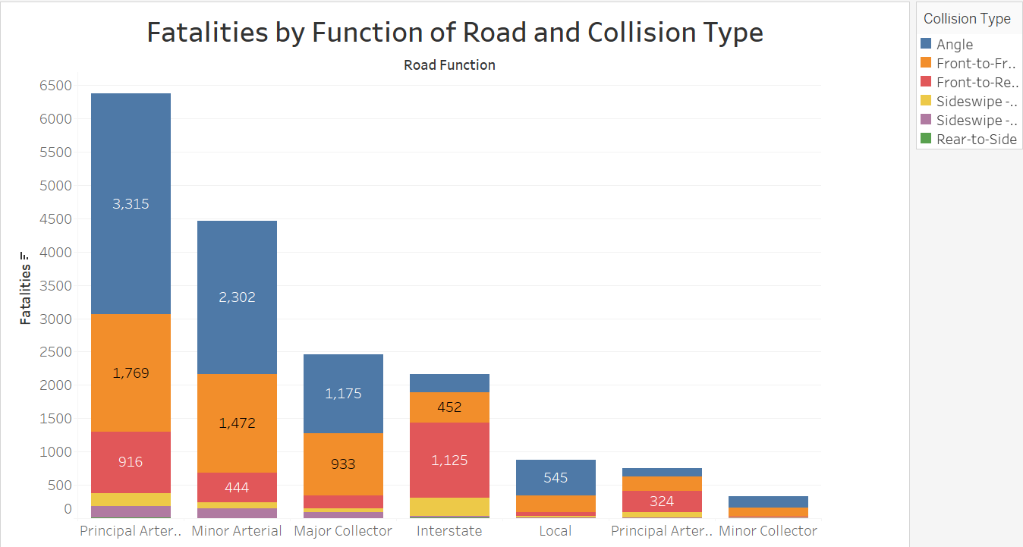
Visualization #2
Principal and minor arterial routes have the most collisions with at least one fatality.
Minor collectors and principal arterial freeways have the lowest count of collisions with at least one fatality.
Angle collisions were the most common collision type on all road functions except for interstate and principal arterial freeways.
Rear-end collisions were the most common collision type on freeways and interstates.

Slide 7
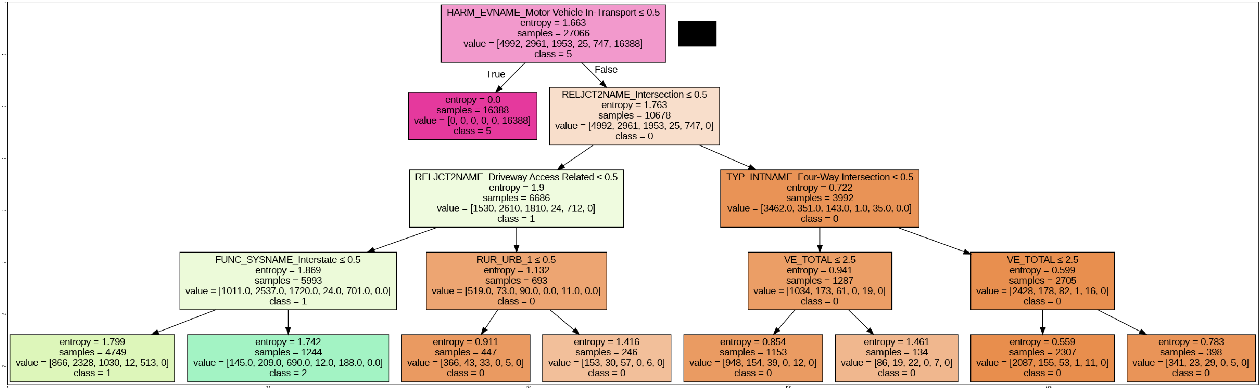
Decision Tree Model
Predicts each collision type for each collision.
80/20 train test split.
The root node was harm event = motor vehicle in transport.
This model can be used to help reduce the number of specific collision types if we know the common factors for each collision type.

Slide 8
Decision Tree Model (Cont.)
Rear-end collisions were most common on freeways and interstates likely because traffic travels at high speeds and drivers who do not maintain a safe following distance are at risk of rear ending the drivers in front of them.
Unsurprisingly, angle collisions are most commonly found at 4-way intersections. It does not specify if they are at a signalized intersection though.
Driveway access points are another common location for angle collisions.

Slide 9
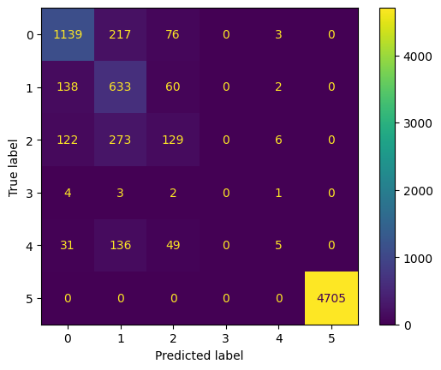
Naïve Bayes Model
Classifies each collision into a specific collision type.
Predicted “no collision with another vehicle in transport” with 100% accuracy.
Was unable to predict collision types with little representation in the dataset such as rear-to-side and sideswipe.
There were a lot of false positives for angle collisions (0) and head on collisions (1).
0 = angle collision, 1 = head-on collision, 2 = rear-end collision, 3 = rear-to-side, 4 = sideswipe, 5 = No collision with another vehicle in transport.

Slide 10

Findings
A common theme is that vehicle speed combined with number of intersections has a significant role in traffic fatalities.
Road functions that have low speeds (local, minor collector) tend to have the lowest count of fatal collisions.
Roads that have high speeds but no intersections such as interstates also have lower counts of fatal collisions.
Collisions that involve pedestrians have higher counts of fatalities.
Rear-end collisions are most commonly found on interstates and high-speed roads with limited access (freeways).

Slide 11
Recommendations
Eliminate unprotected left turns from businesses on to roads that have multiple lanes in each direction and have high vehicle speeds by installing road dividers.
Install more crosswalks in urban areas for pedestrians.
Implement roundabouts at 4-way intersections where traffic volume isn’t too high. Roundabouts are safer since vehicle speeds are lower and head on and angle collisions are eliminated with roundabouts (Ferguson & McCartt, 2003).
Narrow lanes, install pedestrian fences on divided roads or install speed humps to reduce pedestrian fatalities on roads that have a high number of pedestrians struck (Ferguson & McCartt, 2003).
Remove on street parking and implement diagonal parking on streets that have a high number of parked vehicles and pedestrians struck (Ferguson & McCartt, 2003).

Slide 12
Lessons Learned
In datasets that have a lot of features or variables, most rows will have some some unknown variables. Therefore, rows should only be deleted if the target variable is missing or if the data is inaccurate.
It is important to know what each column is measuring. Knowing each column makes it easier when deciding what to do when handling outliers.
Machine learning algorithms are biased when the target variable groups are unevenly distributed. In this project, both models had a high count of false positives for angle collisions and head on collisions, and a lot of false negatives for rear-to-side and sideswipe collisions which were underrepresented in the dataset.
In most scenarios the data should have even representation for all groups but for this project, rear-to-side and sideswipe collisions that result in at least one fatality are rare so having this bias makes the models predictions more realistic.

Slide 13
References
Retting, R. A., Ferguson, S. A., & McCartt, A. T. (2003). A review of evidence-based traffic engineering measures designed to reduce pedestrian-motor vehicle crashes. American journal of public health, 93(9), 1456–1463. https://doi.org/10.2105/ajph.93.9.1456

